Slide 1
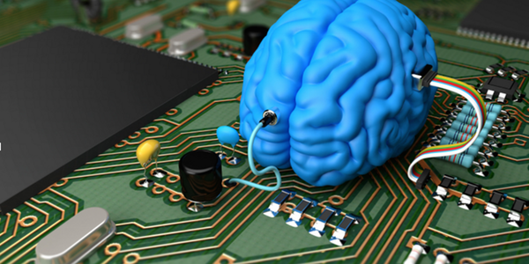
Transfer Learning and Fine Tuning for Cross Domain Image Classification with Keras
Demystifying Deep Learning and Artificial Intelligence
Accel.AI
Presented by: Sujit Pal, Elsevier Labs
November 19-20 2016

Slide 2
About Me
Work at Elsevier Labs
Background in Search
Path into Machine Learning
Started on Natural Language Processing (NLP) to enhance search.
Started on Machine Learning (ML) to help with NLP tasks.
Currently working on Image Search and Classification using Deep Learning and traditional techniques.
Have applied similar ideas using Caffe pre-trained models to classify corpus of images from medical journals.

Slide 3


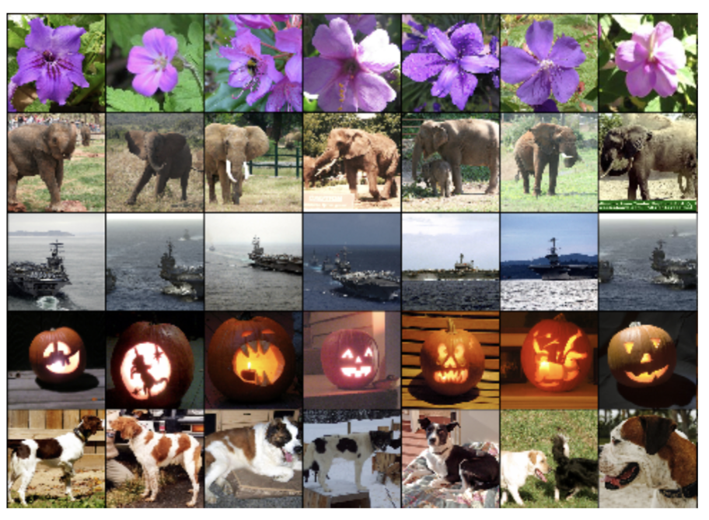
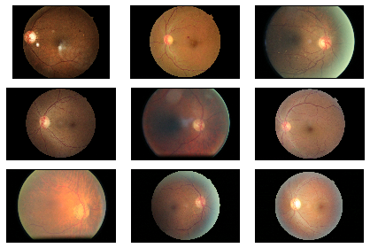
Problem Description
Use Deep Convolutional Neural Networks (DCNN) trained on IMAGENET to predict image classes for a completely different domain.
Photo credits: IMAGENET collage from The Morning Paper; DR Images from Kaggle Diabetic Retinopathy Detection Challlenge

Slide 4
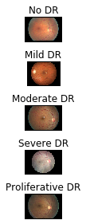
Dataset Description
35,126 color images of the retina.
Labels: No DR, Mild, Moderate, Severe or Proliferative DR.
Detecting DR is hard; done by trained clinicians.
DR identified by presence of lesions on retina associated with vascular abnormality caused by the disease.
Winning entry had 0.86 Kappa score (measures agreement of predictions with labels); good as human performance.
We randomly sample 1,000 images from dataset, 200 for each class.
Photo credits: DR Images from Kaggle Diabetic Retinopathy Detection Challlenge

Slide 5
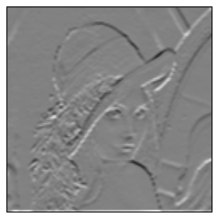
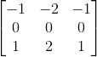
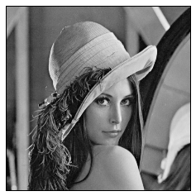
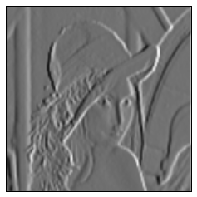
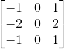
Convolutions as Feature Generators
Convolution is just a matrix operation.
Enhances certain features of image.
Popular approach to image feature generation.
Right Sobel
Bottom Sobel

Slide 6
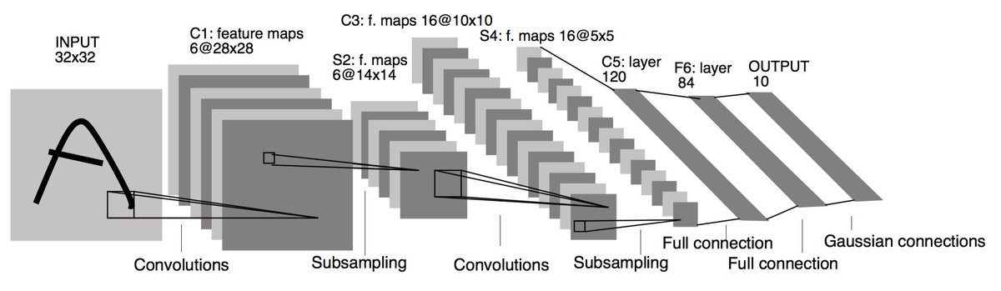
DCNN Architecture
Each layer initialized with random filter weights.
Alternating layers of convolution and pooling.
Filters (depth) increase from left to right.
Multiple filters combined at each pooling layer.
Terminated by one or more fully connected layers.
Filter weights updated by back-propagation during training.

Slide 7
Keras Pre-trained Models
Keras - modular, minimalistic, high level Python library for building neural networks.
Runs on top of Theano and Tensorflow.
Keras Applications (Model Zoo) contains following pre-trained models:
Xception
VGG-16
VGG-19
ResNet50
InceptionV3
We will use VGG-16 for our talk.

Slide 8
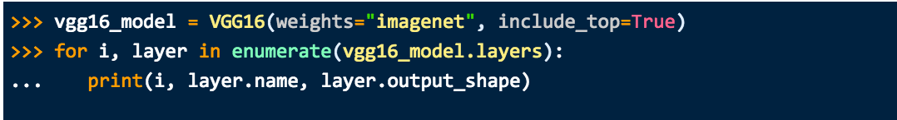
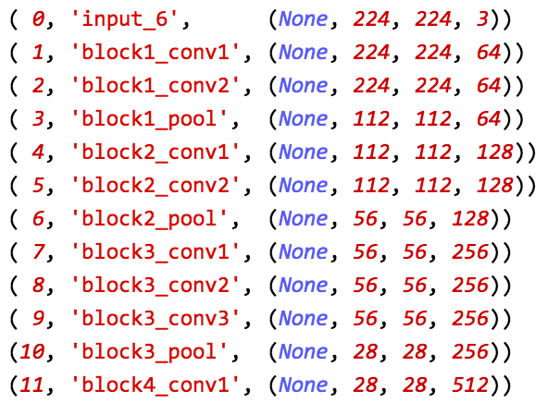
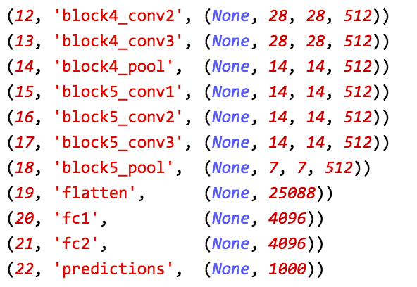
Keras VGG-16 Model

Slide 9
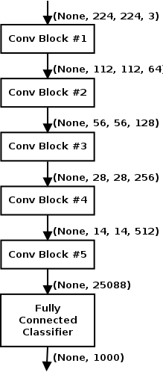
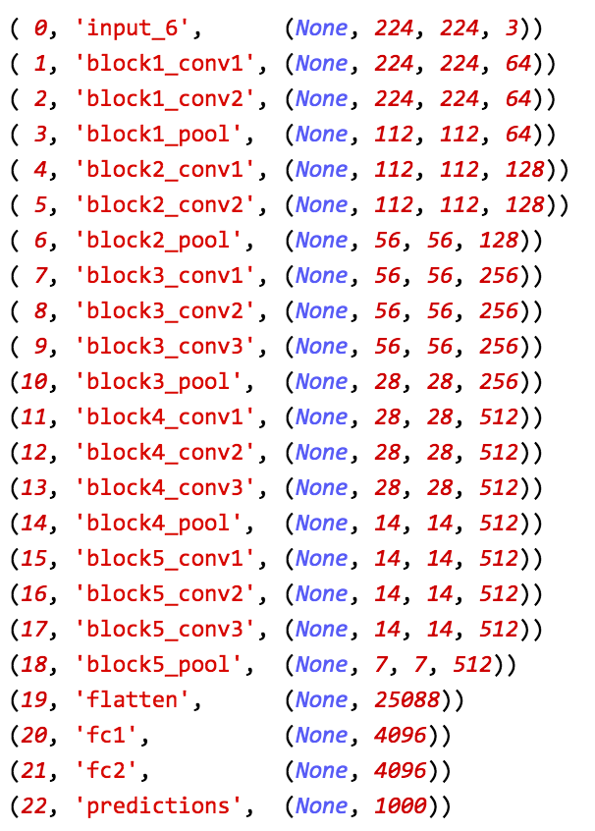
Keras VGG-16 Model

Slide 10
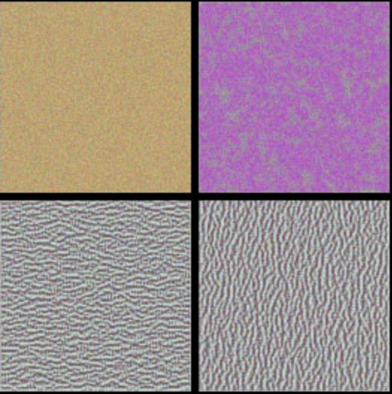
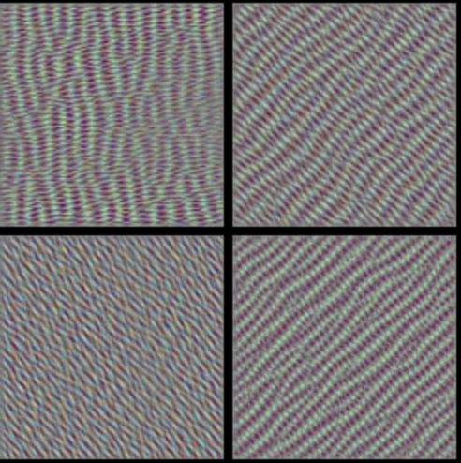
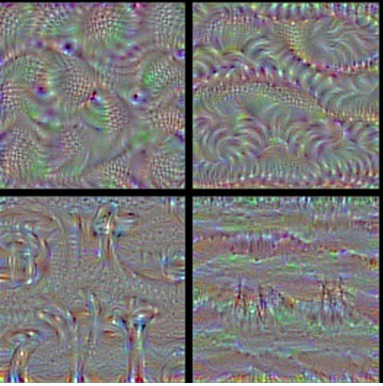
Transfer Learning
Pre-trained model has learned to pick out features from images that are useful in distinguishing one image (class) from another.
Initial layer filters encode edges and color, while later layer filters encode texture and shape.
Cheaper to “transfer” that learning to new classification scenario than retrain a classifier from scratch.
Photo Credit: Keras Blog Post “How Convolutional Networks see the world”

Slide 11
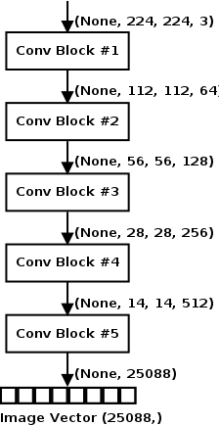
Transfer Learning
Remove the Fully Connected (Bottleneck layer) from pre-trained VGG16 model.
Run images from DR Dataset through this truncated network to produce (semantic) image vectors.
Use these vectors to train another classifier to predict the labels in training set.
Prediction
Image needs to be preprocessed into image vector through truncated pre-trained VGG16 model.
Prediction made with second classifier against image vector.

Slide 12
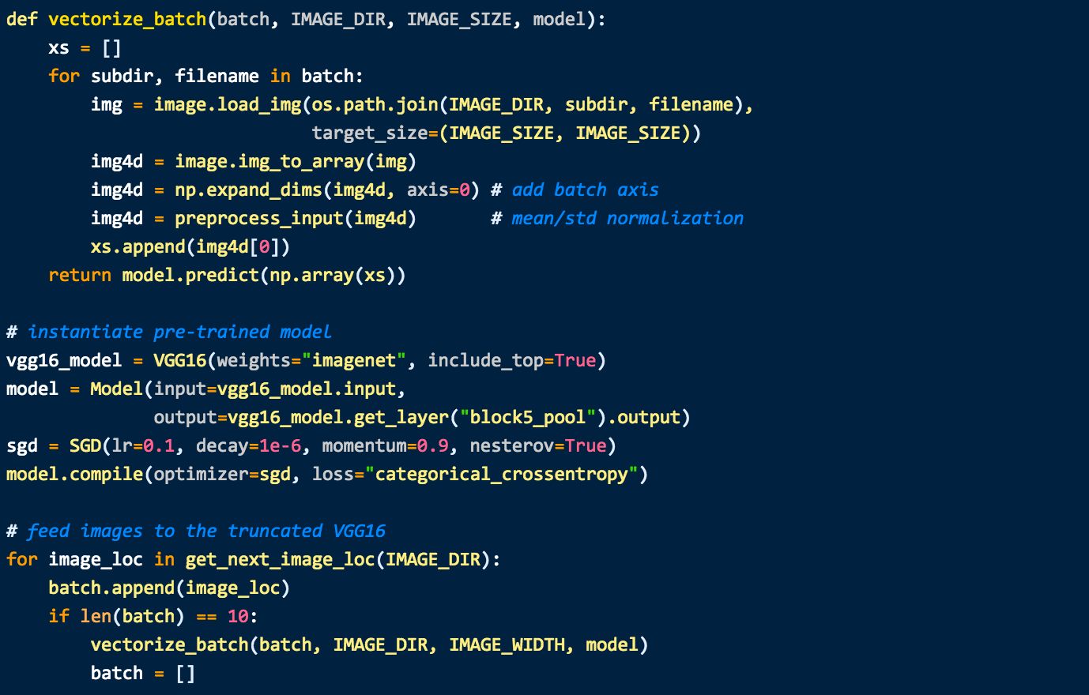
Transfer Learning

Slide 13
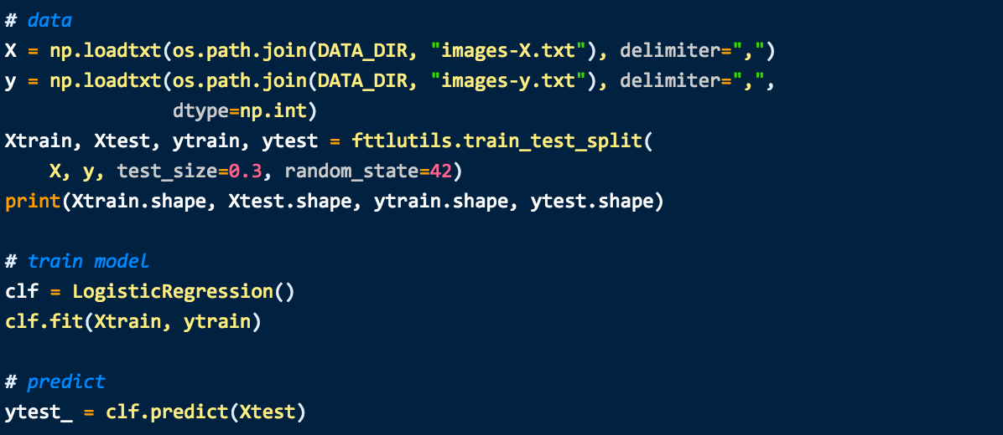
Transfer Learning
Train a classifier (any classifier) using the image vectors.
Accuracy: 0.36, Cohen’s Kappa: 0.51
Position 79-80 on Public Leaderboard (Nov 9 2016).

Slide 14
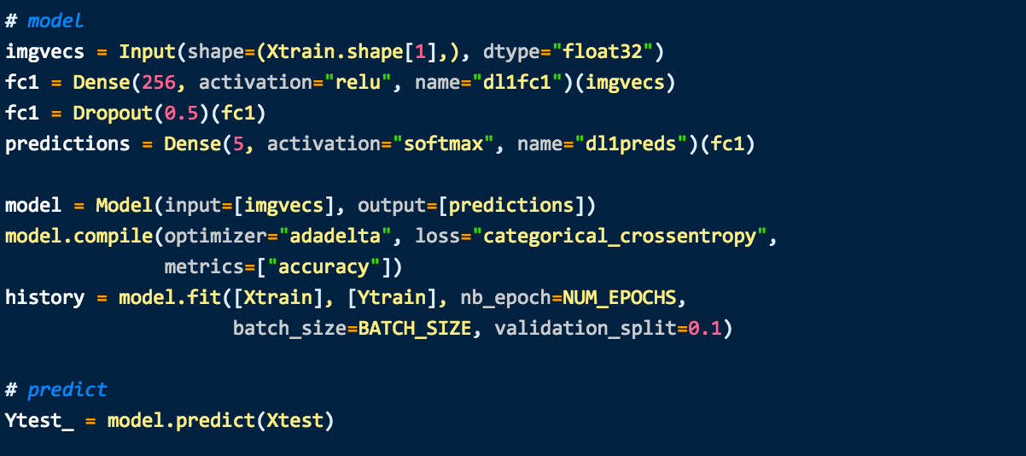
Transfer Learning
Single layer Neural Network gives better results.
Accuracy: 0.67, Cohen’s Kappa: 0.75
Position 25-26 on Public Leaderboard (Nov 9 2016).

Slide 15
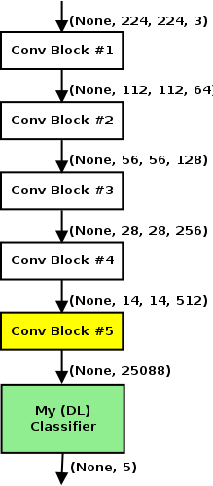
Fine Tuning
Remove bottleneck (classifier) layer from pre-trained network.
Freeze all weights except the last (few) convolutional layers.
Attach our own classifier to the bottom.
Train the resulting classifier with very low learning rate.
Computationally more expensive than Transfer Learning but still cheaper than training network from scratch.
More robust model.

Slide 16
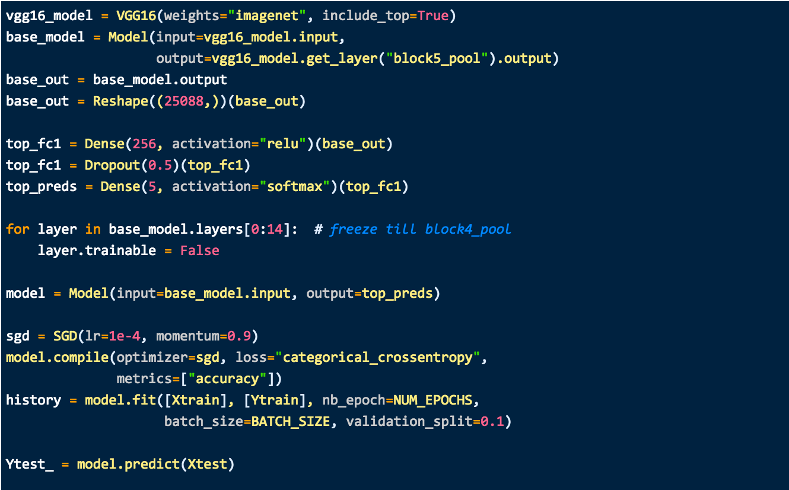
Fine Tuning
Accuracy: 0.62, Cohen’s Kappa: 0.74
Position 26-27 on Public Leaderboard (Nov 9 2016)

Slide 17
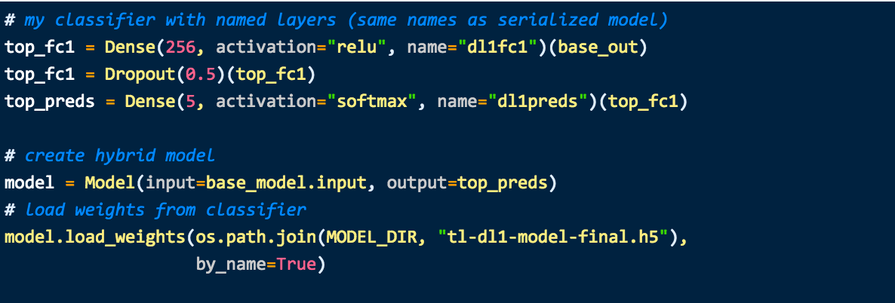
Fine Tuning
Improvement – update weights of top classifier using learned weights from Transfer Learning classifier.
Fewer Epochs needed for convergence.
Accuracy: 0.63, Cohen’s Kappa: 0.72
Position 32-33 on Public Leaderboard (Nov 9 2016)

Slide 18
Code and Contact Info
Code for this talk - https://github.com/sujitpal/fttl-with-keras
My Email Address: sujit.pal@elsevier.com

Slide 19
Thank you

